Slide 1
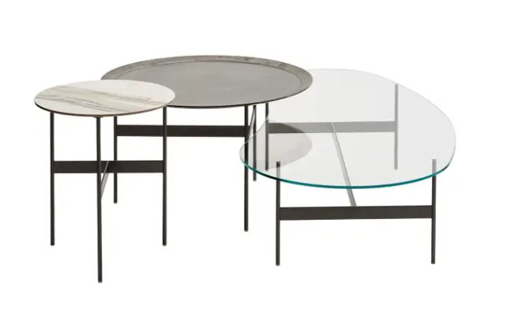
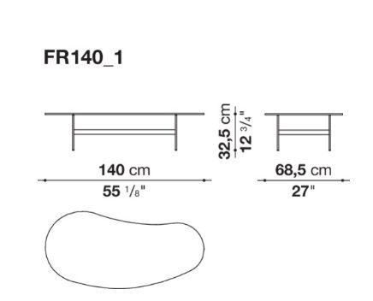
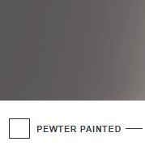
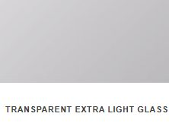
80492151
B&B ITALIA FORMICHE SMALL TABLE
140 cm x 68,5 cm H: 32,5 cm
2pcs
Glass: Transparent Extra Light Glass 0200T
Structure: Pewter Painted 0259V

Slide 2
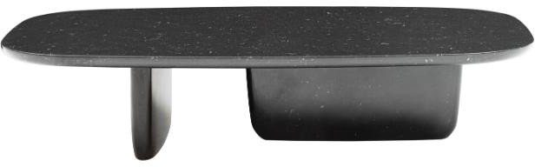
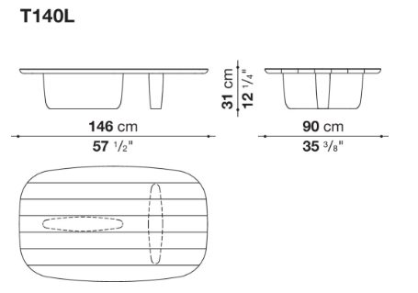
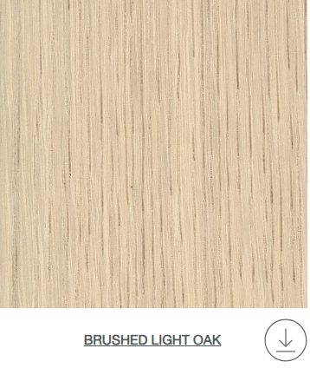
B&B ITALIA TOBI ISHI COFFEE TABLE
Edward Barber & Jay Osgerby,2018
146 x 90 cm H:31 cm
1 pc

Slide 3
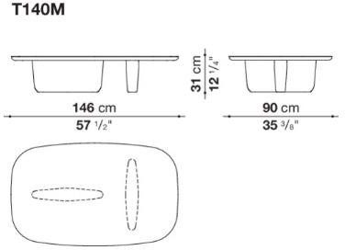

B&B ITALIA TOBI ISHI COFFEE TABLE
Edward Barber & Jay Osgerby,2018
146 x 90 cm H:31 cm
1 pc

Slide 4
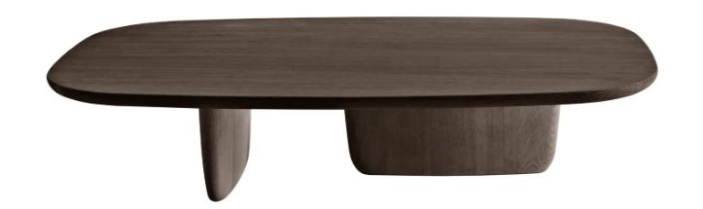
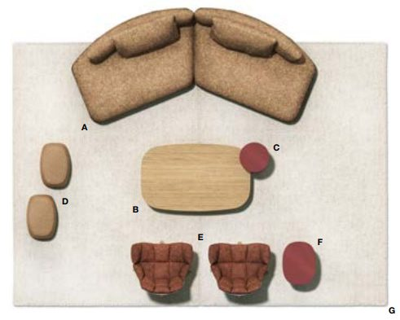

B&B ITALIA TOBI ISHI SMALL TABLE
146cm x 89,5cm h: 41/75cm

Slide 5
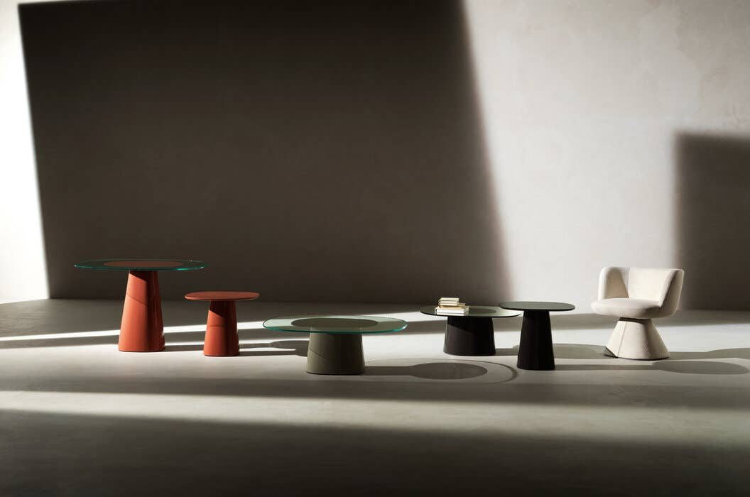
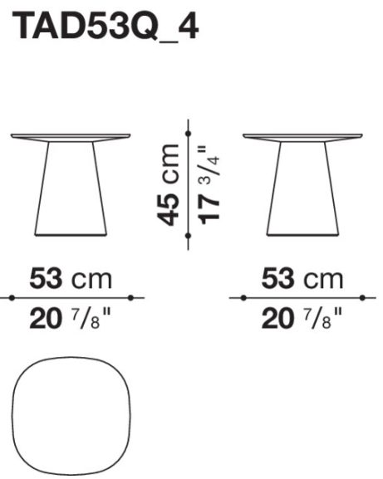
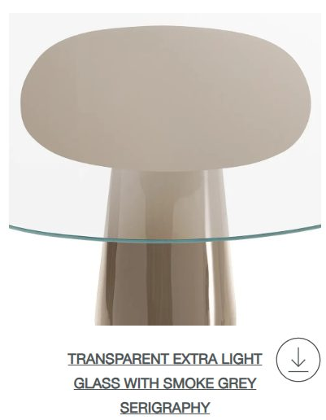


B&B ITALIA ALLURE O DOT SMALL TABLE
53cm x 53cm H: 45cm
Design Monica Armani, 2024
2 pcs;
3 pcs;

Slide 6
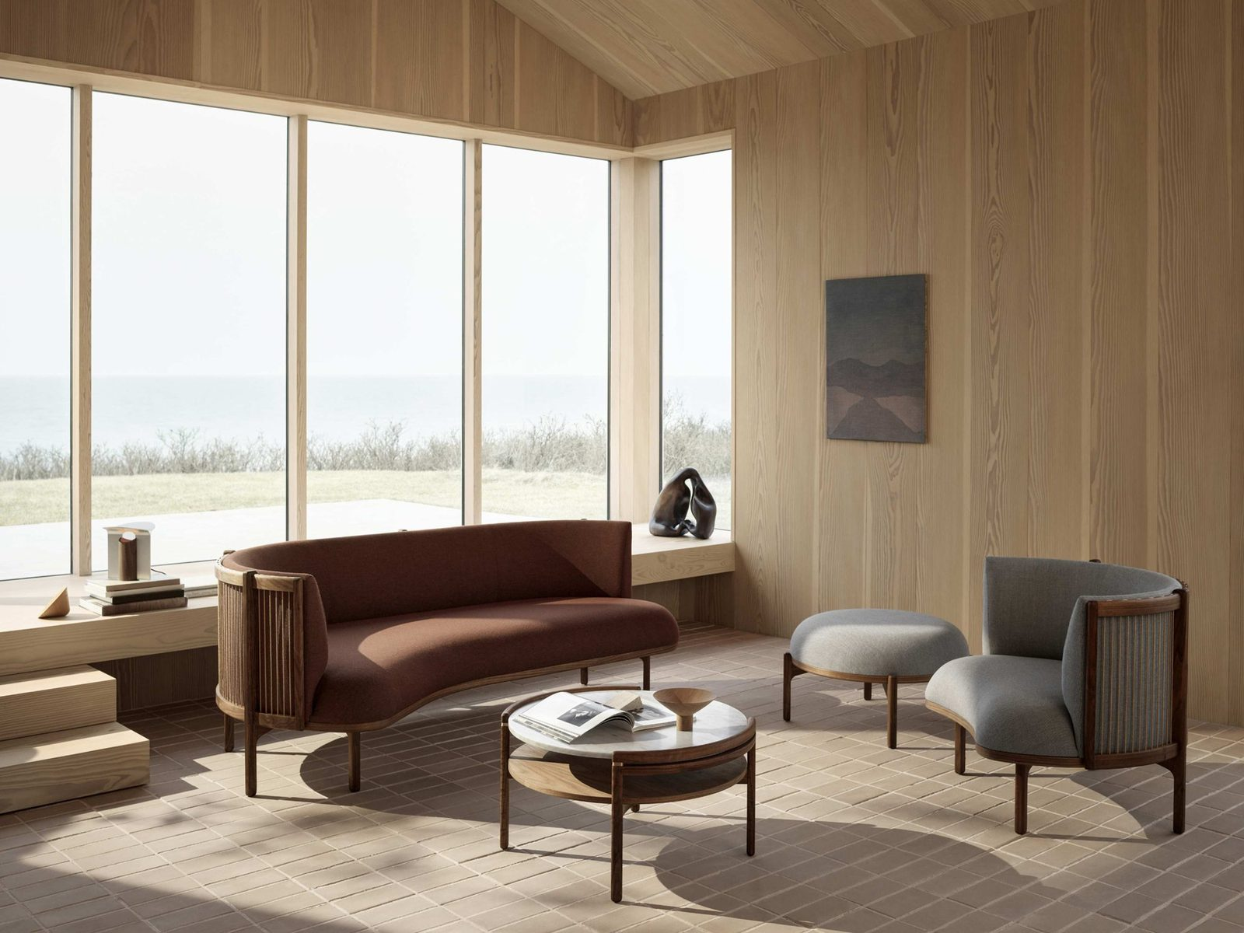
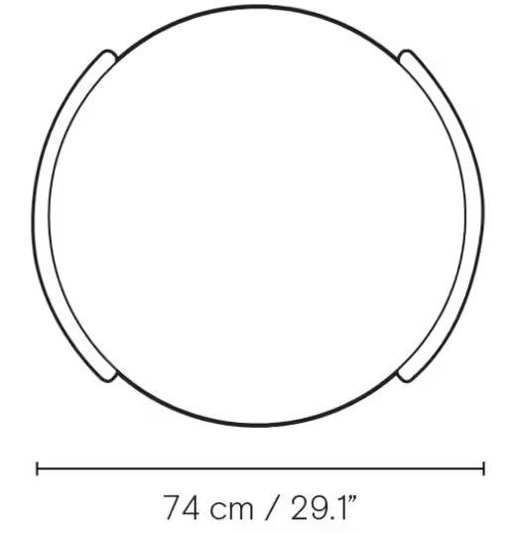
CARL HANSEN&SON SIDEWAYS COFFEE TABLE
Design, Rikke Frost
74cm x 69cm h: 40cm
Walnut oil structure

Slide 7
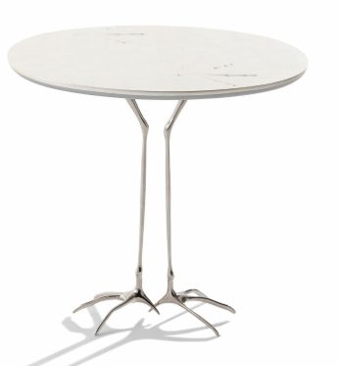
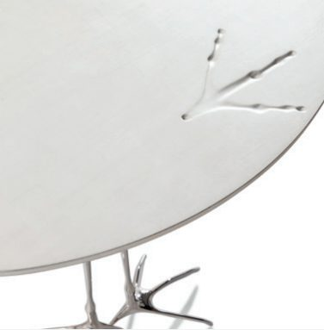
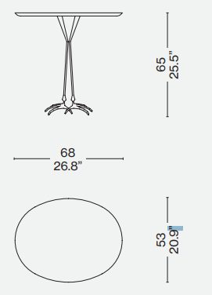

CASSINA TRACCIA LOW TABLE
68 x 53 cm H:65 cm
2 pcs
Design Meret Oppenheim, 1939/ 1972

Slide 8
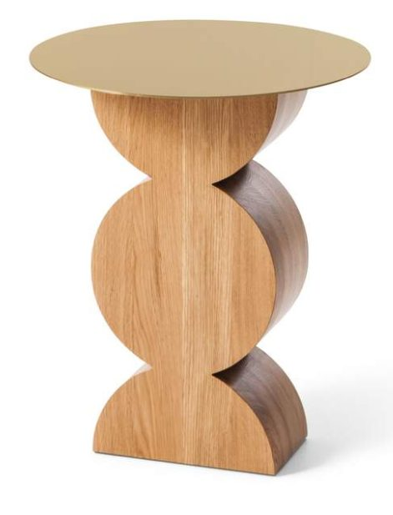
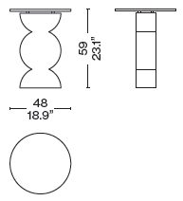
CASSINA CONSTANTIN SIDE TABLE
Franco Albini / 1953
Ø48 cm H:59 cm
1 pc

Slide 9
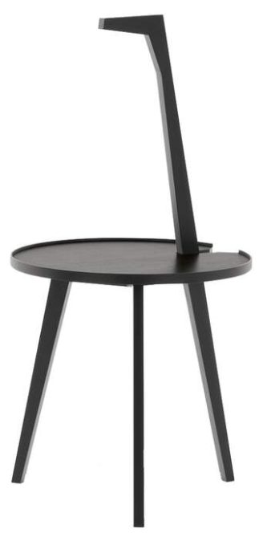
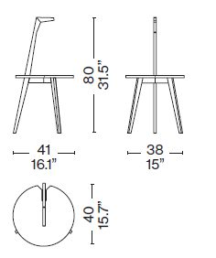
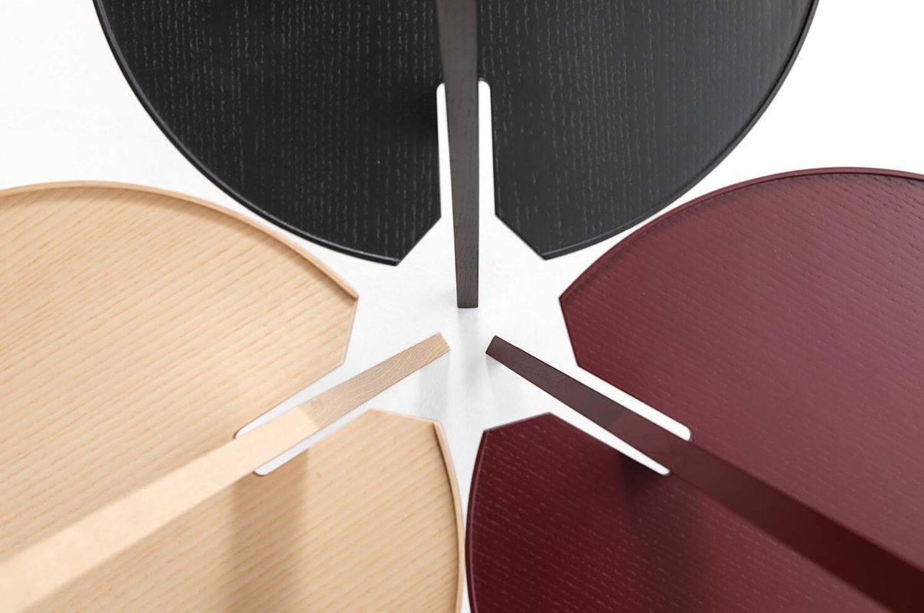
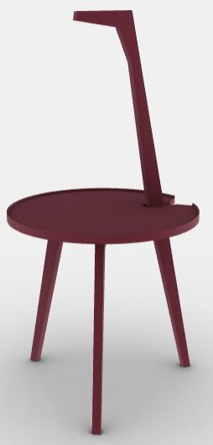
PO.2631
CASSINA CICOGNINO SIDE TABLE
Franco Albini / 1953
Ø48 cm H:59 cm
2 pcs

Slide 10
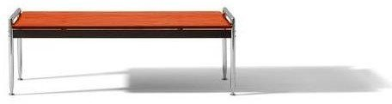
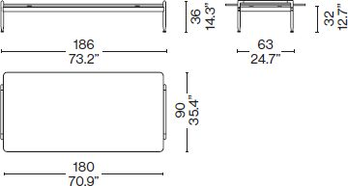
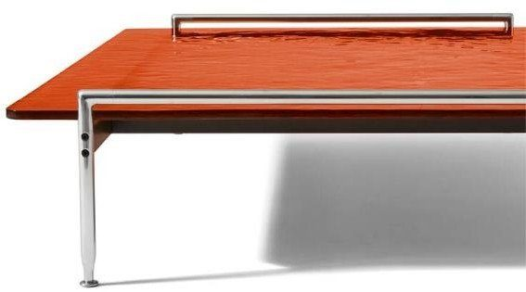
CASSINA ESOSOFT COFFEE TABLE
Antonio Citterio , 2022
186 X 90 cm H:36 cm
2 pcs
TOP;

Slide 11
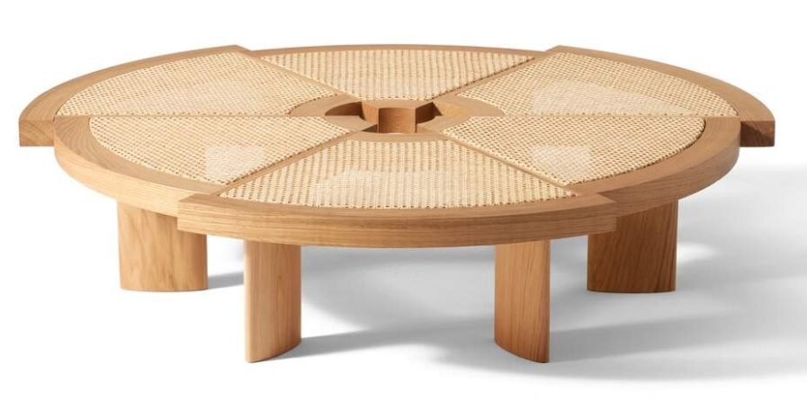
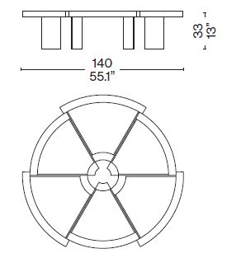

PO.2631
CASSINA RIO COFFEE TABLE
Ø 140cm h:33cm
1 PC

Slide 12
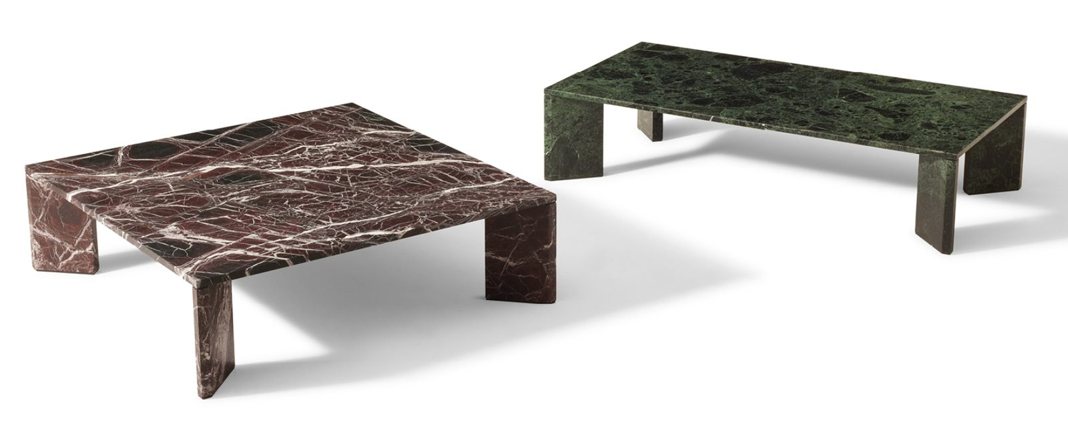
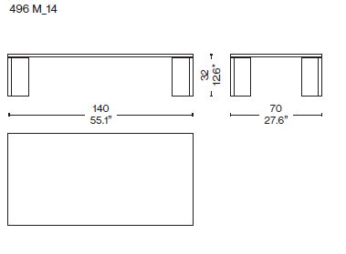
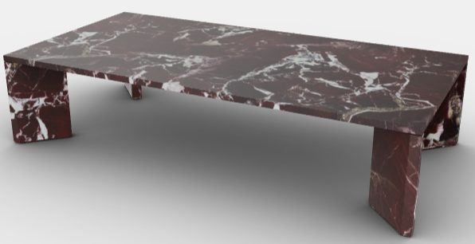
PO.2631
CASSINA ORDINAL COFFEE TABLE
140 x 70 cm, h. 32 cm
1 PC
HAZIRAN 2026

Slide 13
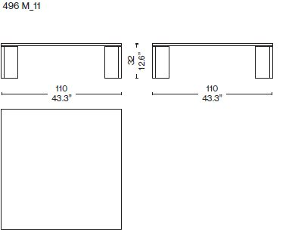
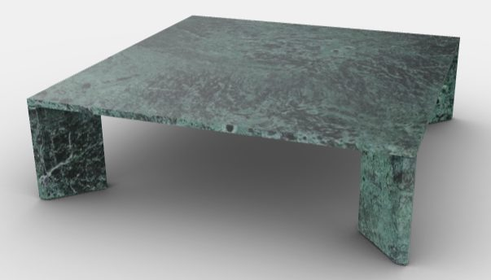
PO.2631
CASSINA ORDINAL COFFEE TABLE
110 x 110 cm, h. 32 cm
2 PCS

Slide 14
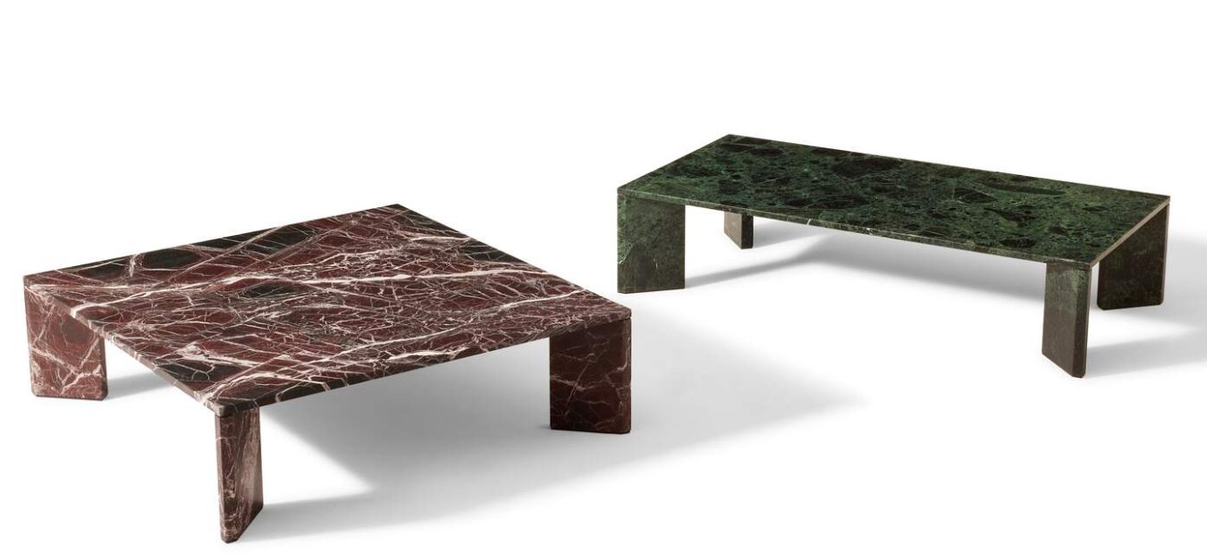
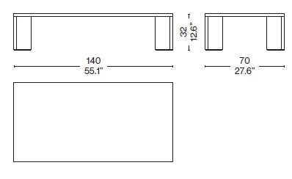
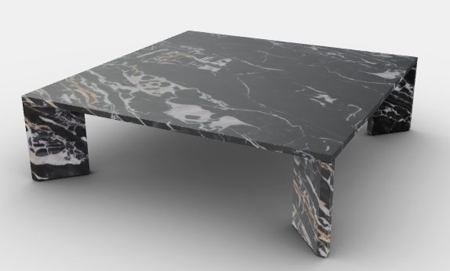

SALONE 2026
CASSINA ORDINAL LOW TABLE
140 cm x 70cm H: 32 cm
2pcs
Structure: Portoro Silver Marble

Slide 15
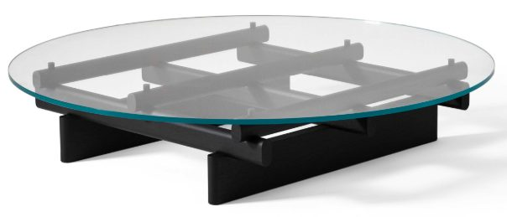
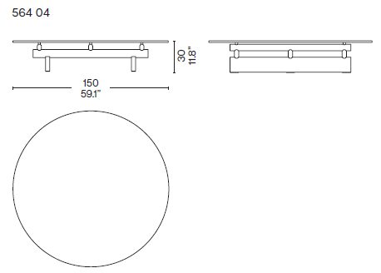
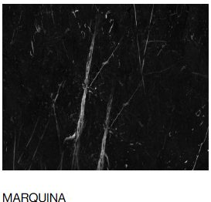

CASSINA SENGU COFFEE TABLE
Patricia Urquiola,2021
Ø150 cm H:30 cm
1 pc

Slide 16

CASSINA SENGU COFFEE TABLE
Patricia Urquiola,2021
Ø150 cm H:30 cm
1 pc

Slide 17
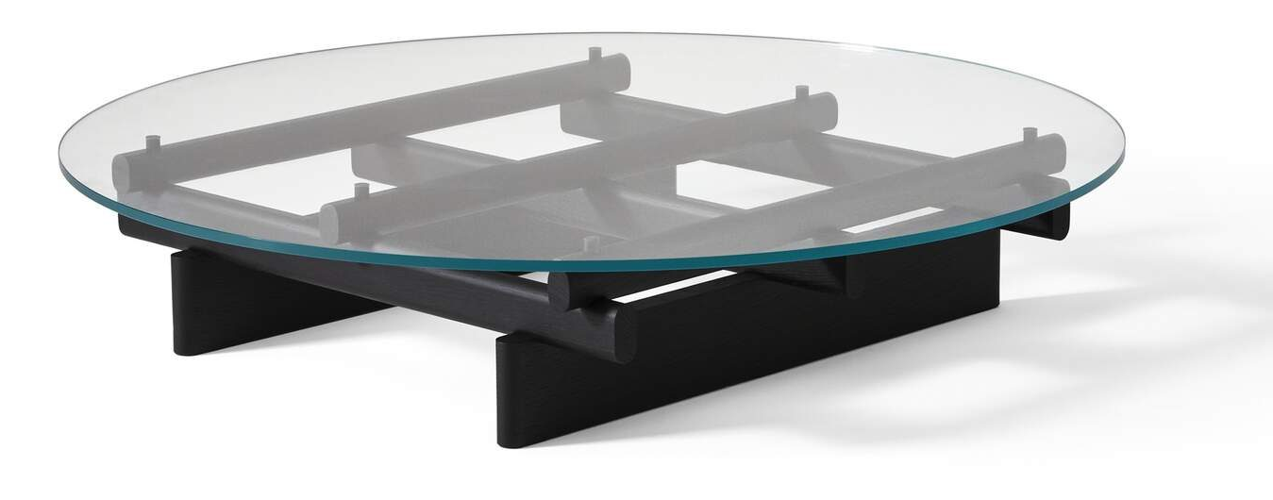
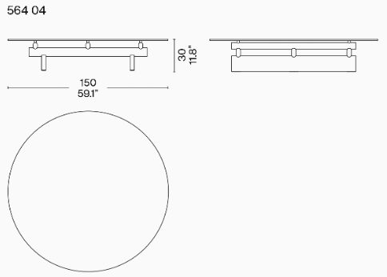
PO.2631
CASSINA 564 SENGU COFFEE TABLE
D: 150 cm H: 30 cm
Patricia Urquiola
MAYIS 2026
1 pcs
Structure: American walnut
Top: Extra clear glass

Slide 18
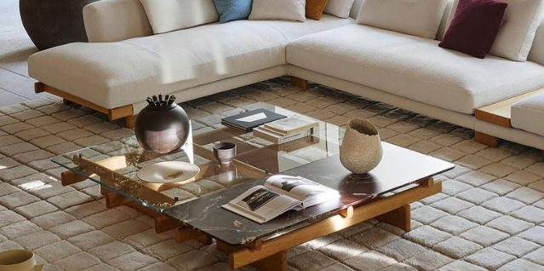
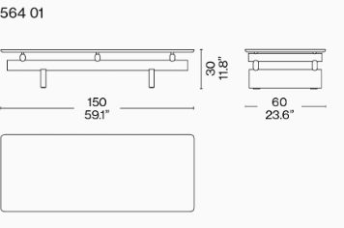
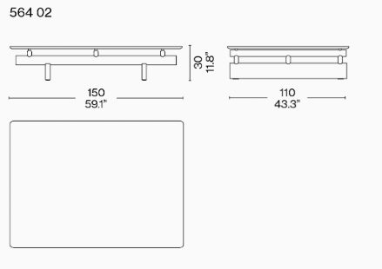
PO.2631
CASSINA 564 SENGU COFFEE TABLE
D: 150 cm x 60 cm H:30 cm
D: 150 cm x 110 cm H:30 cm
Patricia Urquiola
1 pcs
Structure: American walnut
Top: Rosso Levanto Marble
Top: Clear glass

Slide 19
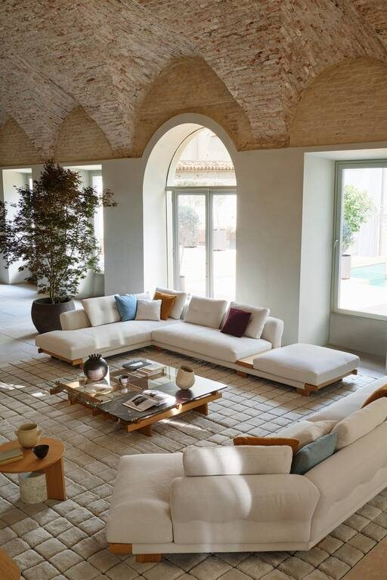
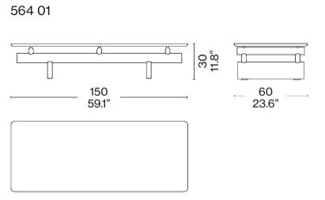
CASSINA SENGU COFFEE TABLE
Patricia Urquıola,2021
150cm x 60cm h: 30cm

Slide 20
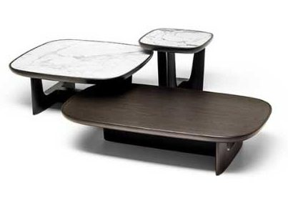
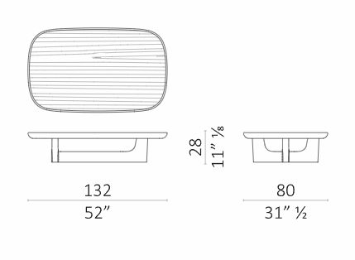


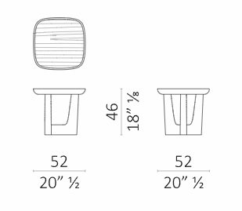


CECCOTTI BALDWIN COFFEE TABLE
132 cm x 80 cm h: 28 cm
52 cm x 52 cm h: 46 cm
52 cm x 52 cm h: 36 cm
1pc set
AĞUSTOS 2026
Top: Marble Top Arabescato
Finish: Ash Stained Wenge
Top: Deep Espresso Glass
Finish: Ash Stained Wenge
Top: Verde Celadon Glass
Finish: Ash Stained Wenge

Slide 21

CECCOTTI BALDWIN COFFEE TABLE
52 cm x 52 cm h: 36 cm
1pc
AĞUSTOS 2026
Top: Ash Stained Wenge PF
Glass Top: Deep Espresso

Slide 22


CLASSICON ADJUSTABLE TABLE E 1027 BLACK
Ø52 cm x 46 cm H: 55/64 cm
4 pcs

Slide 23



CLASSICON OCCASIONAL TABLE ROUND
Ø40 cm x 40 cm H: 43/57 cm
2 pcs
Finish: Black

Slide 24



EDRA CICLADI LOW TABLE
50 x50 cm H:37 cm
50 x50 cm H:43 cm
50 x50 cm H:49 cm
1 SET

Slide 25


EDRA CICLADI LOW TABLE
50 x50 cm H:37 cm
50 x50 cm H:43 cm
50 x50 cm H:49 cm
1 SET

Slide 26



EDRA DIAMANTE TABLE
70 cm x 80 cm H:47 cm
70 cm x 80 cm H:53 cm
1pcs
Finish: Palladium

Slide 27








DE CASTELLI DROP COFFEE TABLE
89cm x 59cm h: 30cm
69cm x 55cm h: 38cm
42cm x 54cm h: 52cm
1 set

Slide 28








DE CASTELLI NICOLA 45 COFFEE TABLE
Ø52 cm H:45 cm
Ø42 cm H:50 cm
Ø35 cm H:55 cm
1 set

Slide 29



DE CASTELLI SUNRISE COFFEE TABLE
Ø95 cm h: 40 cm
1pcs
Top: Gradual Delabre Brass
Base: Dark Delabre Iron M12

Slide 30



DE CASTELLI SUNSET COFFEE TABLE
Ø60 cm h: 50,5 cm
1pcs
Top: Gradual Delabre Copper
Base: Dark Delabre Iron M12

Slide 31



FRITZ HANSEN PK61A COFFEE TABLE
Poul Kjaerholm,1956
120cm x 120cm H:32 cm
1 pc

Slide 32




HENGE BIG BANG COFFEE TABLE
70 cm x 70 cm h: 40 cm
2pcs
Top: Limited Stone Black Pearl
Frame: Sand Cast Peltro

Slide 33



HENGE MUSE TALL TABLE
Ø45 cm H: 50 cm
1pcs
Finish: Metalli H-Pale Gold

Slide 34



HENGE MUSHROOM COFFEE TABLE
32 cm x 32 cm H:60 cm
1pc
Aralık 2026
Structure: Sand Cast Silver

Slide 35

HENGE MUSHROOM COFFEE TABLE
46 cm x 55 cm H:53 cm
1pc
Aralık 2026
Structure: Sand Cast Silver

Slide 36




HENGE ORIGAMI COFFEE TABLE
250 cm x 90 cm H:30 cm
1pcs
ARALIK 2026
Module Finish: Limited Stone Black Pearl /
Sand Cast Peltro

Slide 37




GALLOTTI RADICE SELCE COFFEE TABLE
2023, Pietro Russo
85 x 68 cm h: 36,4 cm
Ø50 cm h:50,4 cm
136 x 70 cm h:30,8 cm
1 pc

Slide 38






PO.2607
GALLOTTI RADICE SELCE COFFEE TABLE
136 cm x 70 cm H:30,8cm
1pcs
85 cm x 68 cm H: 36,4 cm
1pcs
50 cm x 50 cm H: 48cm
1pcs

Slide 39



FENDICASA SANDIA COFFEE TABLE
106 x 95 cm H:25,5 cm 1 PC
88 x 72 cm H:33,5 cm 1 PC

Slide 40




FENDICASA SOHO SIDE TABLE
Ø40 cm H:47 cm 1 PC
Ø55 cm H:35 cm 1 PC

Slide 41


FENDI CASA METROPOLIS COFFEE TABLE
1228x739x400h
PO. 2521133 SHOWROOM
HAZİRAN 2026
1 pcs
TOP FINISHING: V507F FUMÉ CAST GLASS
BASE FINISHING: I304S BRUSHED GUNMETAL

Slide 42



PO.2640
FLEXFORM PLAIN SIDE TABLE
97cm x 97cm h: 35 cm
2pcs
Leather: Tobacco 5015

Slide 43



KNOLL MR LOW TABLE
Ludwig Mies van der Rohe
Ø 72,5cm H:52 cm
Black glass
Matt Black Onyx

Slide 44



KNOLL PLATNER COFFEE TABLE
Warren Platner
Ø40 cm H:46 cm
1 pc
BRONZE GLASS TOP

Slide 45

KNOLL PLATNER COFFEE TABLE
Warren Platner
Ø40 cm H:46 cm
2 pcs

Slide 46

KNOLL PLATNER COFFEE TABLE
Warren Platner
Ø40 cm H:46 cm
1 pcs
CLEAR GLASS TOP

Slide 47

KNOLL PLATNER COFFEE TABLE
Warren Platner
Ø 107cm H: 38,5cm
1 pc
CLEAR GLASS TOP

Slide 48




MAXALTO ALCOR SMALL TABLE
180 cm x 130 cm h: 38 cm
1 pcs

Slide 49





MAXALTO LITHOS SMALL TABLE
180cm x 130cm h: 43,5 cm
1pcs
Top Finish: Extra Light Glass 0200T
Frame Colour: Bronzed Nickel Painted
Lower Shelf Finish: Grey Oak
Cover Bk: Leather AF355N Alfa /
Dark Brown 1425

Slide 50





MAXALTO-ACTION
MAXALTO LITHOS SMALL TABLE
130 cm x 90 cm h: 43,5 cm
1pcs
Top: Extra Light Glass
Cover: Leather AF355N Alfa Dark Brown 1425
Frame: Bronzed Nickel Painted
Finish: Natural Wenge

Slide 51






MOROSO MAGNIAFUOCO SMALL TABLE
D:35 cm h: 48 cm
3 pcs
Top:
1x 00T13 Uranus
1x 00T14 Mars
1x 00T6 Neptune
Base: 201 Noce Canaletto

Slide 52




PROMEMORIA BIP BIP SMALL TABLE
40 cm x 53 cm h:87 cm
2 PCS
Smooth medium bronze

Slide 53





PROMEMORIA BATTISTA COFFEE TABLE
62,5 cm x 47 cm h:57 cm
2 PCS

Slide 54


PROMEMORIA EDON COFFEE TABLE
200 cm x 130 cm h:37 cm
1pc
Smooth dark bronze

Slide 55


PROMEMORIA DJENNE COFFEE TABLE
250 cm x 120 cm h:35 cm
1pc
SATIN AMARANTH

Slide 56


PROMEMORIA FRANCOISE SMALL TABLE
Ø36 cm H:62 cm
2pc
Smooth dark bronze

Slide 57
PROMEMORIA MOSCOU COFFEE TABLE 218 x 128cm H:35 cm
1 pc

Slide 58



PROMEMORIA REBIS COFFEE TABLE
55 cm x 53 cm H:51 cm
2 pcs

Slide 59


PROMEMORIA REBIS COFFEE TABLE
174 x 94 cm H:38 cm
1 pcs

Slide 60



REX KRALJ REX COFFEE TABLE
Niko Kralj, 1957
62 x 63cm H:51 cm
1 pc

Slide 61





ANDREU WORLD NAZAR TABLE
76,5 cm x 75 cm H: 46,5 cm
68 cm x 67 cm H: 36,5 cm
60 cm x 59 cm H: 26,5 cm
3pcs
Finish: Natural Oak Wood

Slide 62






THONET SET B 9 SIDE TABLES
Marcel Breuer 1926
1 set;
1 set;

Slide 63


THONET SET B 97 SIDE TABLES
46cm x 49cm h: 52cm
53cm x 49cm h: 57cm
1 set;
1 set;

Slide 64


THONET SET B 97 SERIOUS 02 and 03 SIDE TABLE
Collaboration with Jil Sander, 2025
53 x 49 cm H:57
46 x 49 cm H:52
1pc ruby red

Slide 65



VITRA NOGUCHI COFFEE TABLE
Isamu Noguchi, 1944
128 x 92cm H:40 cm
2 PCS;

Slide 66




WITTMAN ACACIA TABLE
Ø42 cm H:55 cm
4pcs
2 pcs
2 pcs
Leather: Eldorado Olivo
Black Chrome
Glass: Murano Glass Fume

Slide 67


WITTMAN ACACIA TABLE
Ø42 cm H:55 cm
2pcs
1 pc
1 pc

Slide 68


WITTMAN GRAIN CUT TABLE
Ø28 cm W:42 cm H:40 cm
1 pc
Structure: Ash Solid Black Stained

Slide 69



ZANOTTA QUADERNA COFFEE TABLE
Superstudio, 1972-2022
90 x 90 cm H:30 cm
1 pc

Slide 70






ZANOTTA TOD SIDE TABLE
55 x 43 cm H:52cm
2 pcs;
2 pcs;
2 pcs;

Slide 71
BOOK SHELVES

Slide 72




B&B ITALIA JACK WALL UNIT
Michael Anastassiades,2018
312 x 44 cm H:236 cm
1 pc

Slide 73


CAPPELLINI REVOLVING CABINET
80cm x 80cm H: 192cm
2 pcs

Slide 74




CASSINA INFINITO WALL UNIT
Franco Albini , 2020
1 pc
Structure;

Slide 75



DE CASTELLI EXISTENCE 5 FLOORS BOOKCASE
123 cm x 41 cm H: 166 cm
1pcs
Metal: DeLabre B Stainless Steel E5

Slide 76



MDF ITALIA RANDOM 3C
46 cm x 25 cm H:217 cm
2pcs
Finish: Matt Burgundy

Slide 77


VITRA EAMES STORAGE UNIT ESU
120 cm x 43 cm H:148 cm
1pc

Slide 78
CONSOLES/SIDE BOARDS

Slide 79




PO.2642120
CASSINA ANTELLA CONSOLE
Kazuhide Takahama, 2013
169 x 63 cm H:72cm
1 pc

Slide 80


CASSINA RONDOS CONSOLE
Paticia Urquiola , 2020
280 x 50 cm H:55 cm
1 pc
Structure;

Slide 81




CECCOTTI FULL TV UNIT
Roberto Lazzeroni
254cm x 56cm h:58cm
1 pc
AMERICAN WALNUT
CALACATTA ORA
STAINED MOKA

Slide 82



CECCOTTI TEAHOUSE CABINET WITH ACCESSORIES
Christophe Pillet
106cm/57cm x 45cm h: 132/75 cm
1 pc

Slide 83




CECCOTTI TROLLEY DUO D60
Ø60 cm h: 81 cm
1pcs
ARALIK 2026
Glass: Tortora NCS S3005Y50R
Finish: Ash Stained Wenge PF
Marble: Calacatta

Slide 84




CECCOTTI TROLLEY BLOODY MARY
82 cm x 50 cm H: 30/80 cm
1pcs
ARALIK 2026
Glass: Blu Scuro NCS S8010R90B
Tray: Colored Glass
Finish: American Walnut Stained Brown

Slide 85



CIMENTO RIVA CONSOLE
145 cm x 45 cm H: 81 cm
1pcs

Slide 86


GALLOTTI RADICE RIKI TROLLEY
Ø 60cm h: 69cm
2 pcs

Slide 87



DE CASTELLI CELATO 80 CHEST OF DRAWERS
75 cm x 40 cm H: 82 cm
2pcs
Metal: DeLabre Brass F2
Structure: Natural Birch

Slide 88




DE CASTELLI PANDORA CHEST OF DRAWERS
Ø48 cm H:102cm
Ø48 cm H:127 cm
2pcs
Metal: Delabre Stainless Steel AISI 304 E7
Structure: Natural Oak

Slide 89


EDRA SCRIGNO CABINET
199 cm x 47 cm H:73 cm
1pcs

Slide 90






PO.2607
GALLOTTI RADICE SENSEI CONSOLE
180 cm x 35 cm H:80 cm
1pcs
Structure: Deep Black
Marble: Calacatti Vagli
Accessories Tray: Leather
Fard Ecru 2304 Category L1

Slide 91




MAXALTO ALCOR CONSOLE
Antonio Citterio , 2014
240cm x 46cm h:72 cm
1 pc

Slide 92




SDM2026
MAXALTO ALCOR CONSOLE
240 cm x 46 cm H: 90 cm
EYLUL 2026
1pcs
Finish: Black Shellac 3764G
Handle Colour: Bronzed Nickel Painted 0174B

Slide 93





MAXALTO PATHOS CONSOLE
Antonio Citterio, 2011
190cm x 45cm h:72.5 cm
GUATEMALA GREEN MARBLE
BRONZED NİCKEL PAINTED

Slide 94

MAXALTO PATHOS CONSOLE
Antonio Citterio, 2011
190cm x 45cm h:72.5 cm
CALACATTA WHITE MARBLE
BRONZED NİCKEL PAINTED

Slide 95


PROMEMORIA REBIS CONSOLE
200 x 40 cm H:75 cm
1 pc

Slide 96



SEM MILANO BUTTERFLY CONSOLE
170 cm x 35 cm H: 92,5 cm
Hannes Peer
AĞUSTOS 2026
1pcs
Finish: Red concrete handmade resin finish with highcrafted glossy effect

Slide 97


102090684
USM HALLER SERVICE ELEMENT
125 x 50 cm H:90+4cm
1 pc

Slide 98

USM HALLER SERVICE ELEMENT
75x50 cm h:70 + 8 cm
1 pc

Slide 99

USM HALLER SERVICE ELEMENT
75x50 cm h:64 + 8 cm
2 pcs

Slide 100


USM HALLER TV UNIT
1 pc

Slide 101

USM HALLER TV UNIT
2 pcs

Slide 102

USM HALLER STORAGE
290 cm x 35 cm H: 210 + 4 cm
1pcs
Finish: Brown - Glass

Slide 103

USM HALLER STORAGE
300 cm x 35 cm h: 192 + 4 cm
1pcs
Finish: Anthracite - Glass

Slide 104

USM HALLER STORAGE
295 cm x 35 cm h: 190 + 4 cm
1pcs
Finish: Beige - Glass

Slide 105
BEDS

Slide 106



80492151
B&B ITALIA ALYS LETTO BED
207 cm x 212 cm H: 39/92 cm
1pcs
Leather: Thick 350
Fabric: Black Colour 0154N

Slide 107


80504255
B&B ITALIA ALYS LETTO BED
207 cm x 212 cm H: 39/92 cm
2pcs

Slide 108




80504255
B&B ITALIA ALYS 10 LETTO BED
200 cm x 217 cm H: 30/103 cm
1pcs

Slide 109



SALONE 2026
CASSINA MON NID BED
180 cm x 200 cm H: 53 cm
1pcs
Frame: Fully Apholstered
Fabric: Tessuto Fox Bianco 13FF04

Slide 110



EDRA STAND BY ME BED
240-268 cm x 215 cm H: 32 cm
1pcs

Slide 111

EDRA STAND BY ME BED
240-268 cm x 215 cm H: 32 cm
1pcs

Slide 112






MDW 26
FLEXFORM GREGORY BED
185 cm x 224 cm H: 22/85 cm
1pcs
Cover: Medina N.92
Leather: Dark Brown 5004
Piping: Gros Grain Col.99
Finish: Chrome

Slide 113



MDW 26
FLEXFORM GREGORY BED
185 cm x 224 cm H: 22/85 cm
1pcs
Cover: Loira N 148
Leather: Dark Brown 5004
Piping: Gros Grain Col.44
Finish: Burnished

Slide 114



PO.25161
FLEXFORM GREGORY BED
185 cm x 224 cm H: 22/85 cm
1pcs

Slide 115




PO.2224
MAXALTO FEBO BED
204 x 235 cm H:32/104,5 cm
1pcs

Slide 116



MAXALTO-ACTION
MAXALTO FEBO BED
204 cm x 235 cm H: 32/104,5 cm
1pcs

Slide 117





B&B ITALIA QUIET LINES SIDE TABLE
Gabriel Tan, 2023
45cm x 60cm H:46 cm
1 pcs

Slide 118



DE CASTELLI PANDORA CHEST OF DRAWERS
Ø48 cm H: 52 cm
2pcs
Metal: Delabre Stainless Steel AISI 304 E7
Structure: Natural Oak

Slide 119



DE CASTELLI CELATO BEDSIDE TABLE IRIDIUM EDITION
SPECIAL RAL CODE INSIDE
52cm x 40cm H: 45cm
2pcs

Slide 120




GALLOTTI RADICE CLEMO COFFEE TABLE
Massimo Castagna, 2021
Ø49cm h: 40cm
2 pcs

Slide 121


FIAM ITALIA TOKI SIDE TABLE
Setsu & Shinobu Ito
43cm x 52cm H:60cm
2 pcs

Slide 122



GALLOTTI RADICE HIDE&SEEK MINI COFFEE TABLE
2024, Pietro Russo
Ø 47 cm h: 44,5 cm
2 pc

Slide 123





MAXALTO AMPHORA BEDSIDE TABLE
Antonio Citterio,2004
63.5cm x 48cm h:60 cm
2 PCS

Slide 124

USM HALLER NIGHT TABLE
75x35 cm h:55+4 cm
2 pcs
WEEK 34

Slide 125

USM HALLER NIGHT TABLE
75x35 cm h:55+4 cm
2 pcs
WEEK 34

Slide 126

USM HALLER NIGHT TABLE
50x35 cm h:50+4 cm
2 pcs
WEEK 34

Slide 127

USM HALLER NIGHT TABLE
75x35 cm h:45+4 cm
1 pc

Slide 128
MIRRORS

Slide 129


CASSINA GIBBOUS MIRROR with LED
80 x 17 cm H:67 cm
115 x 22 cm H:96 cm

Slide 130

CASSINA GIBBOUS MIRROR without LED
80 x 17 cm H:67 cm

Slide 131
CASSINA GIBBOUS MIRROR without LED
115 x 22 cm H:96 cm

Slide 132


CASSINA LES GRANDS TRANS-PARENTS MIRROR
Man Ray, 1938
91 x 181 cm
1 pc

Slide 133


CASSINA ME FROM OUTSIDE / WE SEE WHAT WE WANT TO SEE
183 cm x 92 cm
Pietro Terzini
2 pcs

Slide 134


CASSINA ME FROM OUTSIDE / YOU ARE ART MIRROR
183 cm x 92 cm
Pietro Terzini
ŞUBAT 2026
2pcs

Slide 135



CLASSICON PIEGA MIRROR
Victoria Wilmotte, 2018
145 x 15 H:75 cm
1 pcs

Slide 136


GALLOTTI RADICE LEAF SCULPTURE
Ricardo Bello Dias, 2019
215 x 200 cm & 180 x 235 cm
1 pc

Slide 137


GALLOTTI RADICE SOLE MIRROR
Studio G&R, 2007
Ø150 cm
2 PCS

Slide 138
GALLOTTI RADICE SOLE MIRROR
Studio G&R, 2007
Ø165 cm
2 PCS

Slide 139



GALLOTTI RADICE ZEIS MIRROR
Studio G&R, 2007
80 x 78 cm
104 x 92 cm
156 x 151 cm
1 SET

Slide 140

GALLOTTI RADICE ZEIS MIRROR
Studio G&R, 2007
80 x 78 cm
104 x 92 cm
156 x 151 cm
1 SET

Slide 141




B&B ITALIA MADISON SQUARE MIRROR
142cm x 142cm
2pcs
Mirror Finish: Grey Mirror
Frame: Bronze Nickel Painted

Slide 142


B&B ITALIA MADISON SQUARE MIRROR
84 cm x 161,5 cm
2pcs
Mirror Finish: Grey Mirror
Frame: Bronze Nickel Painted

Slide 143



MAXALO PSICHE MIRROR
80cm x 21cm h: 220 cm
2pcs
MART 2026
Frame: Bronze Nickel Painted

Slide 144



PO.25141
FIAM ITALIA CAADRE MIRROR
105 cm x 105 cm
1 pcs

Slide 145

PO.25141
FIAM ITALIA CAADRE MIRROR
105 cm x 105 cm
1 pcs

Slide 146


PO.25141
FIAM ITALIA CHRISTINE MIRROR
195 cm x 100 cm x 23 cm
1 pcs

Slide 147


PO.25141
FIAM ITALIA DORIAN MIRROR
202 cm x 105 cm x 10 cm
1 pcs

Slide 148


PO.25141
FIAM ITALIA ROSY MIRROR
D: 130 cm
1 pcs

Slide 149


PO.25141
FIAM ITALIA ROSY MIRROR
D: 130 cm
1 pcs

Slide 150


PO.25141
FIAM ITALIA SILICA MIRROR
100 cm x 200 cm x 5 cm
1 pcs

Slide 151


PO.25141
FIAM ITALIA SHIFT MIRROR
182 cm x 87 cm x 4 cm
1 pcs

Slide 152


PO.25141
FIAM ITALIA SHIFT MIRROR
182 cm x 87 cm x 4 cm
1 pcs

Slide 153




FLEXFORM MATE MAGAZINE HOLDER
56cm x 52cm h: 34 cm
1 PC

Slide 154



CECCOTTI CAPTAIN HOOK WALL CLOCK
30 cm x 10 cm H:194 cm
2 pcs
AĞUSTOS 2026
Finish: American Walnut Stained Moka
Finish: Dark Shellac

Slide 155



CECCOTTI DUO LAMP
28,5 cm H: 185 cm
2pcs
AĞUSTOS 2026
Finish: Ash Stained Wenge PF
220V

Slide 156



CLASSICON MANDU VALET STAND
41cm x 38cm h:109cm
3 pcs;
3 pcs;
3 pcs;

Slide 157


CLASSICON NYMPHENBURG COAT STAND
49 cm x 44 cm H: 180 cm
1pc nickel
1pc black powder coated

Slide 158



TOLIX COAT RACK FAMILY TREE
52 x 47 cm H:168cm
2 PCS

Slide 159



ZANOTTA SCIANGAI CLOTHES STAND
De Pas, D’Urbino, Lomazzi, 1973
65 x 65cm h:145cm
OAK DYED ASH (X5)
BLACK DYED ASH (X6)
MULTICOLOR (X3)
AMARANTH (X1)

Slide 160
OUTDOOR

Slide 161






B&B ITALIA ERICA 25 SOFA
Antonio Citterio, 2025
216 x 96 cm H: 40/65cm
PROFILE;

Slide 162



B&B ITALIA ERICA 25 SOFA
Antonio Citterio, 2025
216 x 96 cm H: 40/65cm
SEAT;
BACK;
PROFILE;

Slide 163







SH.2659
B&B ITALIA ERICA DORMEUSE SOFA
240 cm x 120 cm H: 40/65 cm
EYLÜL 2026
2pcs
Finish: Hay Green Interlacing-Olive Bronze Frame 0424B
2x Seat Cushion: Ester Green 400
2x Back Cushion: Silvia Green Yellow 445
2x Lumbar Cushion: Ester Green 400
Profile: Brick Colour 0068M

Slide 164







SH.2659
B&B ITALIA ERICA SOFA
244 cm x 120 cm H: 53/65 cm
EYLÜL 2026
2pcs
Finish: Hay Green Interlacing Olive Bronze Frame 0424B
2x Seat Cushion: Lilia White 100
2x Back Cushion: Silvia Beige Tobacco 213
2x Lumbar Cushion: Sirena Blended Mustard 458
Profile: Natural Colour 0082N

Slide 165







B&B ITALIA ERICA SOFA
216cm x 86cm h:40/65 cm
2 pcs
2 pcs lumbar cushion;

Slide 166





B&B ITALIA ERICA HIGH CHAIR
61cm x 60cm h: 63/75 cm
6pcs
NISAN 2026
Finish: Hay Green Interlacing 0424B
Fabric: Lamone 385 / Red
6x Cushion: Lamone 385

Slide 167





B&B ITALIA ERICA SMALL ARMCHAIR
80 cm x 78 cm h: 40/65 cm
2pcs
Antonio Citterio
MAYIS 2026
Structure: Beige Interlacing
Seat Cushion: Larice Brick 370
Back Cushion: Lamone 385

